Slide 1
JavaScript DOM
by Yurii Holskyi

Slide 2
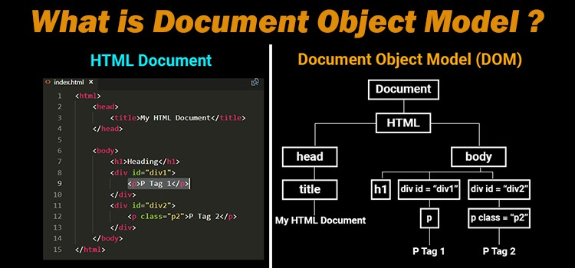
What is JavaScript DOM?
When a page is loaded, the browser creates a Document Object Model of the page.
The HTML DOM model is constructed as a tree of Objects.

Slide 3
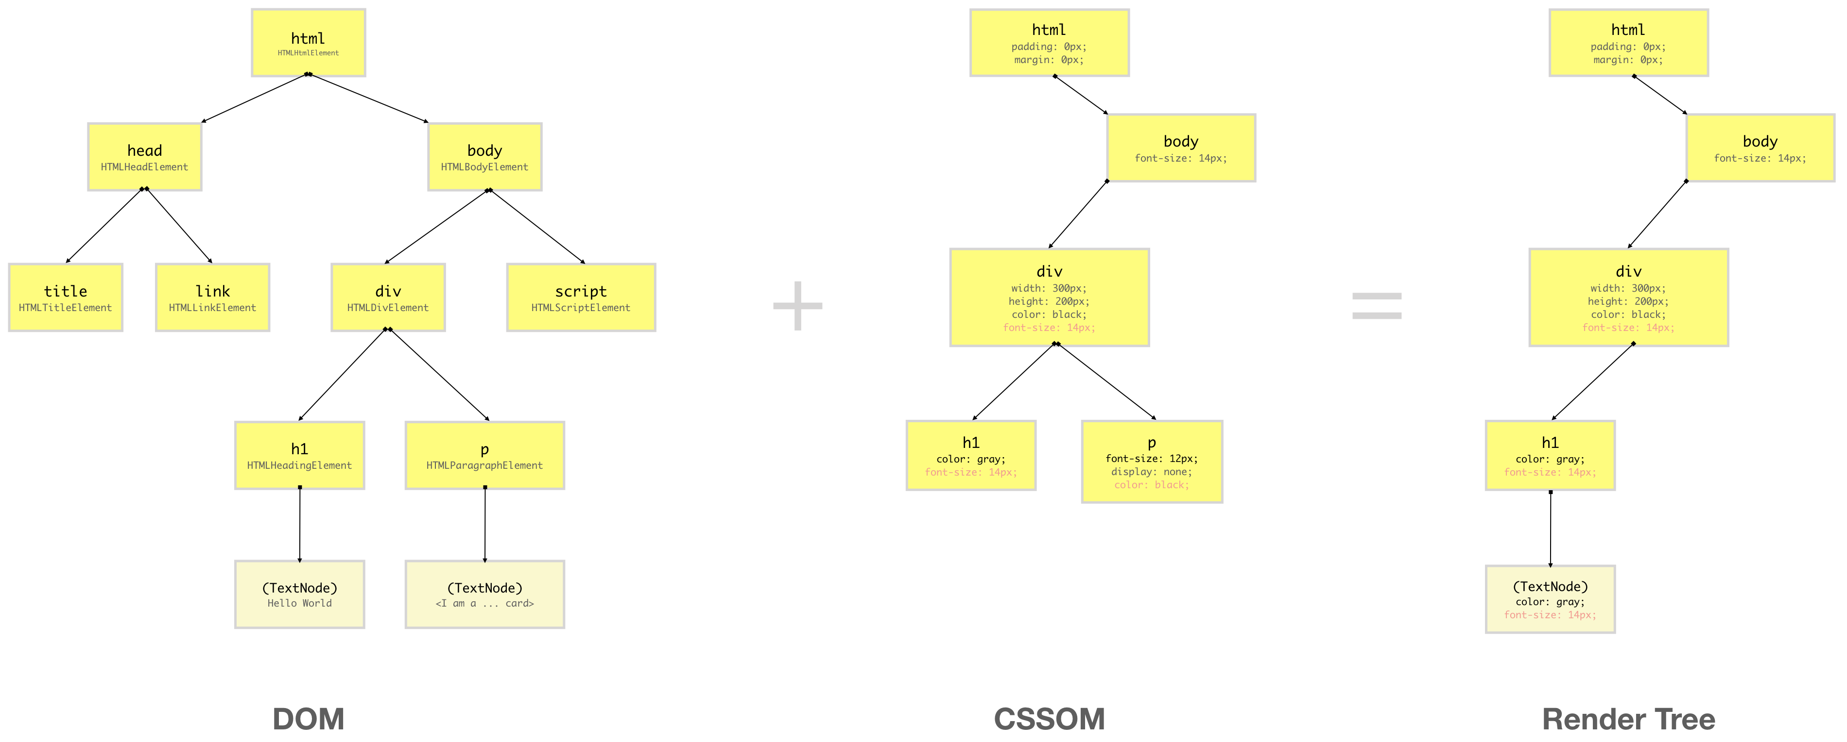
Render tree

Slide 4
Render tree
When a web page is loaded, the browser first reads the TEXT HTML and constructs DOM Tree from it.
Then it processes the CSS whether that is inline, embedded or external CSS and constructs the CSSOM Tree from it.
After these trees are constructed, then it constructs the Render-Tree from it. Once the Render-Tree is constructed, then the browser starts the printing individual elements on the screen.

Slide 5
Layout, Paint and Composition operation
Layout:
The first browser creates the layout of each individual Render-Tree node. The layout consists of the size of each node in pixels and where (position) it will be printed on the screen.
Paint:
Now that we have layers, we can combine them and draw it on the screen. But the browser does not draw all the layers in a single image. Each layer is drawn separately first.
Composition:
Until now, we haven’t drawn a single pixel on the screen. What we have are different layers (bitmap images) which should be drawn on the screen in a specific order. In compositing operations, these layers are sent to GPU to finally draw it on the screen.

Slide 6
Power of DOM
With the js DOM you can:
1) Can change all the HTML elements in the page;
2) Can change all the HTML attributes;
3) Can change all the CSS styles in the page;
4) Can remove existing HTML elements and attributes;
5) Can add new HTML elements and attributes;
6) Can react to all existing HTML event in the page;
7) Can create new HTML events in the page.
“The W3C Document Object Model (DOM) is a platform and language-neutral interface that allows programs and scripts to dynamically access and update the content, structure, and style of a document.”

Slide 7
DOM Standarts
DOM level 1 provided a complete model for an entire HTML or XML, including the means to change any portion of the document;
DOM level 2 was published in late 2000. It introduced the getElementById function as well as an event model;
DOM level 3, published in April 2004, added keyboard event handling;
DOM level 4 was published in 2015. It is a snapshot of the WHATWG living standard.
(https://en.wikipedia.org/wiki/WHATWG).

Slide 8
document
In js we have a document object, which have some properties:
1) documentElement – root element (html);
2) body – body element;
3) images – all images on the page (img elelements);
4) links - all links with href attribute;
5) forms – all forms on page (form element).

Slide 9
DOM Methods
HTML DOM methods are actions you can perform on HTML Elements.
HTML DOM properties are values (of HTML Elements) that you can set of change.
Example:
document.getElementById(‘test’).innerHTML = ‘Whatever’;
In the example above, getElementById method used id – test to find the element.
The easiest way to get the content of an element is by using the innerHTML property.
The innerHTML property is useful for getting or replacing the content of HTML elements.
Another property to change content is textContent or innerText, but it just change text of elements not exactly elements.

Slide 10
DOM Methods
Finding HTML Elements
document.getElementsById(id) – find element by element id;
document.getElementsByTagName(name) – -//- by tag name;
document.getElementsByClassName(name) - -//- by class name;
document.querySelector(selector) - -//- by CSS selector;
document.querySelectorAll(selector) - -//- by CSS selector, but return NodeList.
Changing HTML Elements
element.innerHTML = newContent – change the inner HTML of an element;
element.attribute = newValue – change attribute value of an element;
element.style.property = newStyle – change style of an element.
element.setAttribute(attribute, value) – change the attribute value.
element.getAttribute(attribute) – get the attribute value.
element.removeAttribute(attribute) – remove the attribute value.

Slide 11
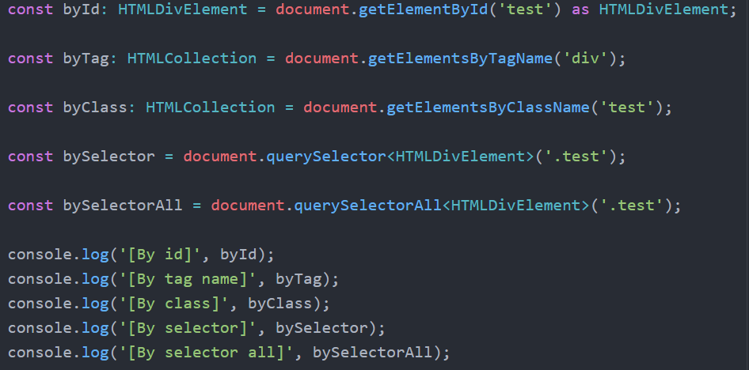
DOM Methods example
Finding HTML Elements

Slide 12
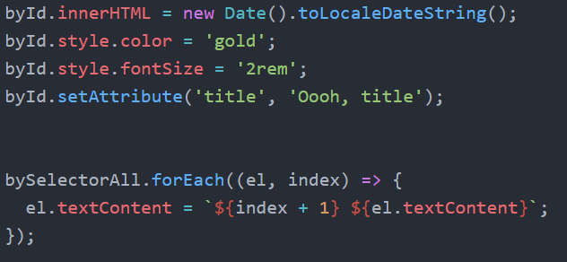
DOM Methods example
Changing HTML Elements

Slide 13
DOM Methods and Event handling
Adding and Deleting Elements
document.createElement(element) – create an HTML element;
document.removeChild(element) – remove an HTML element;
(also have a element.remove() method)
document.appendChild(element) – add an HTML element;
document.replaceChild(newEl, oldEl) – replace an HTML element;
document.insertBefore(newEl, beforeEl) – insert an HTML element before element;
Event handling
document.querySelector(‘.test’).onevent = () => { code… } or
document.querySelector(‘.test’).addEventListener(‘event’, () => { code … });

Slide 14
insertAdjacentElement
It’s very powerful method to insert elements. This method insert html into specific position.
Position values are:
1) "afterbegin“; 2) "afterend“; 3) "beforebegin“; 4) "beforeend“.
element.insertAdjacentHTML(position, newEl);
More info (https://www.w3schools.com/jsref/met_node_insertadjacentelement.asp)

Slide 15
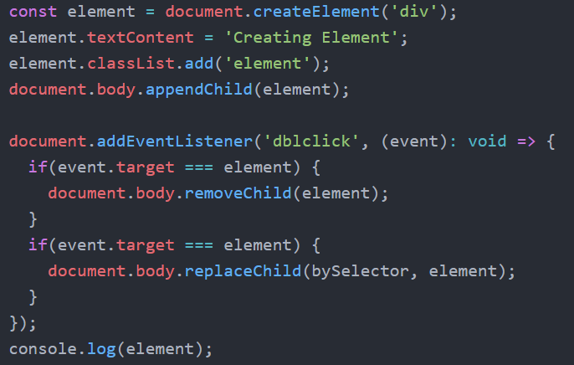
DOM Methods and Event handling
Adding and Deleting Elements

Slide 16
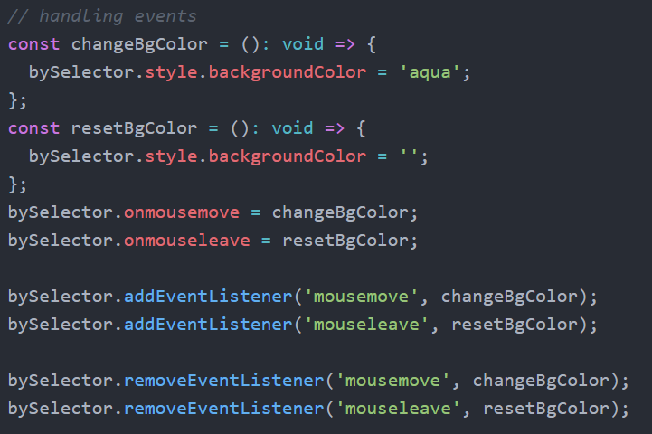
DOM Methods and Event handling
Event handling

Slide 17
DOM Working with HTML classes
All elements have property classList and you can add classes, remove, toggle or check if class exist.
1) document.querySelector(‘.test’).classList.add(‘test-1’) – added class “test-1”;
2) document.querySelector(‘.test-1’).classList.remove(‘test’) – removed class “test”;
3) document.querySelector(‘.test’).classList.toggle(‘test-2’) – toggle class “test-2”;
4) document.querySelector(‘.test’).classList.contains(‘test-1’) – check if class “test-1” exist on element;

Slide 18
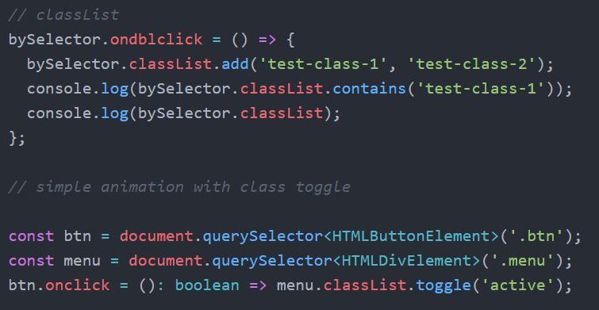
DOM Working with HTML classes
Working with classes

Slide 19
DOM Working with HTML classes
Working with classes

Slide 20
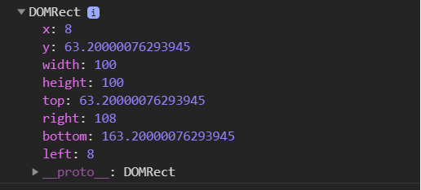
DOM Element sizes
We can check the width and height of the element.
Methods to get width and height is element.offsetWidth and element.offsetHeight respectively.
This methods includes border sizes. If we want to get sizes without border, we can use
element.clientWidth and element.clientHeight
Also we can get a position of element used element.getBoundingClientReact().

Slide 21
HTML collections
Methods getElementByTagName and getElementsByClassName return a HTML collection. Is an array-like list of HTML elements.
An HTMLCollection is NOT an array!
An HTMLCollection may look like an array, but it is not.
You can loop through the list and refer to the elements with a number (just like an array).
However, you cannot use array methods like valueOf(), pop(), push(), or join() on an HTMLCollection.
But, we can create array from collection using Array.from method of spread operator.

Slide 22
NodeList
Method querySelectorAll return a NodeList. It’s like HTML collection, but... only the NodeList object can contain attribute nodes and text nodes. And it’s also not array.
We alos can create array from NodeList using Array.from method of spread operator.

Slide 23
Thank You

